Slide 1
Relations
Chapter 9
Copyright © McGraw-Hill Education. All rights reserved. No reproduction or distribution without the prior written consent of McGraw-Hill Education.

Slide 2
Chapter Summary
Relations and Their Properties
n-ary Relations and Their Applications (not currently included in overheads)
Representing Relations
Closures of Relations (not currently included in overheads)
Equivalence Relations
Partial Orderings

Slide 3
Relations and Their Properties
Section 9.1

Slide 4
Section Summary
Relations and Functions
Properties of Relations
  Reflexive Relations
  Symmetric and Antisymmetric Relations
  Transitive Relations
Combining Relations

Slide 5
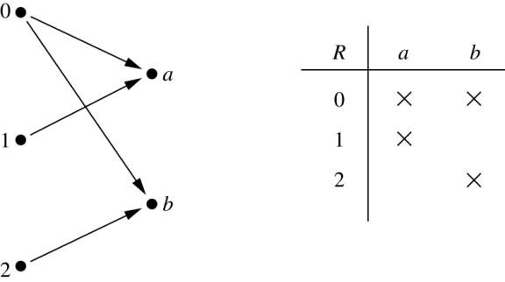
Binary Relations
Definition: A binary relation R from a set A to a set B is a subset R ⊆ A × B.
Example:
  Let A = {0,1,2} and B = {a,b}
  {(0, a), (0, b), (1,a) , (2, b)} is a relation from A to B.
  We can represent relations from a set A to a set B graphically or using a table:
Relations are more general than functions. A function is a relation where exactly one element of B is related to each element of A.

Slide 6
Binary Relation on a Set
Definition: A binary relation R on a set A is a subset of A × A or a relation from A to A.
Example:
  Suppose that A = {a,b,c}. Then R = {(a,a),(a,b), (a,c)} is a relation on A.
  Let A = {1, 2, 3, 4}. The ordered pairs in the relation R = {(a,b) | a divides b} are
  (1,1), (1, 2), (1,3), (1, 4), (2, 2), (2, 4), (3, 3), and (4, 4).

Slide 7
Binary Relation on a Set (cont.)
    Question: How many relations are there on a set A?
    Solution: Because a relation on A is the same thing as a subset of A ⨉ A, we count the subsets of A × A. Since A × A has n² elements when A has n elements, and a set with m elements has 2^{m} subsets, there are subsets of A × A. Therefore, there are relations on a set A.

Slide 8
Binary Relations on a Set (cont.)
Example: Consider these relations on the set of integers:
  R₁ = {(a,b) | a ≤ b}, R₄ = {(a,b) | a = b},
  R₂ = {(a,b) | a > b}, R₅ = {(a,b) | a = b + 1},
  R₃ = {(a,b) | a = b or a = −b}, R₆ = {(a,b) | a + b ≤ 3}.
  Which of these relations contain each of the pairs
  (1,1), (1, 2), (2, 1), (1, −1), and (2, 2)?
Solution: Checking the conditions that define each relation, we see that the pair (1,1) is in R₁, R₃, R₄ , and R₆: (1,2) is in R₁ and R₆: (2,1) is in R₂, R₅, and R₆: (1, −1) is in R₂, R₃, and R₆ : (2,2) is in R₁, R₃, and R₄.
Note that these relations are on an infinite set and each of these relations is an infinite set.

Slide 9
Reflexive Relations
Definition: R is reflexive iff (a,a) ∊ R for every element a ∊ A. Written symbolically, R is reflexive if and only if
∀x[x∊U ⟶ (x,x) ∊ R]
Example: The following relations on the integers are reflexive:
  R₁ = {(a,b) | a ≤ b},
  R₃ = {(a,b) | a = b or a = −b},
  R₄ = {(a,b) | a = b}.
  The following relations are not reflexive:
  R₂ = {(a,b) | a > b} (note that 3 ≯ 3),
  R₅ = {(a,b) | a = b + 1} (note that 3 ≠3 + 1),
  R₆ = {(a,b) | a + b ≤ 3} (note that 4 + 4 ≰ 3).
If A = ∅ then the empty relation is reflexive vacuously. That is the empty relation on an empty set is reflexive!

Slide 10
Symmetric Relations
Definition: R is symmetric iff (b,a) ∊ R whenever (a,b) ∊ R for all a,b ∊ A. Written symbolically, R is symmetric if and only if
  ∀x∀y [(x,y) ∊R ⟶ (y,x) ∊ R]
Example: The following relations on the integers are symmetric:
  R₃ = {(a,b) | a = b or a = −b},
  R₄ = {(a,b) | a = b},
  R₆ = {(a,b) | a + b ≤ 3}.
  The following are not symmetric:
  R₁ = {(a,b) | a ≤ b} (note that 3 ≤ 4, but 4 ≰ 3),
  R₂ = {(a,b) | a > b} (note that 4 > 3, but 3 ≯ 4),
  R₅ = {(a,b) | a = b + 1} (note that 4 = 3 + 1, but 3 ≠4 + 1).

Slide 11
Antisymmetric Relations
Definition:A relation R on a set A such that for all a,b ∊ A if (a,b) ∊ R and (b,a) ∊ R, then a = b is called antisymmetric. Written symbolically, R is antisymmetric if and only if
  ∀x∀y [(x,y) ∊R ∧ (y,x) ∊ R ⟶ x = y]
Example: The following relations on the integers are antisymmetric:
  R₁ = {(a,b) | a ≤ b},
  R₂ = {(a,b) | a > b},
  R₄ = {(a,b) | a = b},
  R₅ = {(a,b) | a = b + 1}.
  The following relations are not antisymmetric:
  R₃ = {(a,b) | a = b or a = −b}
  (note that both (1,−1) and (−1,1) belong to R₃),
  R₆ = {(a,b) | a + b ≤ 3} (note that both (1,2) and (2,1) belong to R₆).
For any integer, if a a ≤ b and a ≤ b , then a = b.

Slide 12
Transitive Relations
Definition: A relation R on a set A is called transitive if whenever (a,b) ∊ R and (b,c) ∊ R, then (a,c) ∊ R, for all a,b,c ∊ A. Written symbolically, R is transitive if and only if
  ∀x∀y ∀z[(x,y) ∊R ∧ (y,z) ∊ R ⟶ (x,z) ∊ R ]
Example: The following relations on the integers are transitive:
  R₁ = {(a,b) | a ≤ b},
  R₂ = {(a,b) | a > b},
  R₃ = {(a,b) | a = b or a = −b},
  R₄ = {(a,b) | a = b}.
  The following are not transitive:
  R₅ = {(a,b) | a = b + 1} (note that both (3,2) and (4,3) belong to R₅, but not (3,3)),
  R₆ = {(a,b) | a + b ≤ 3} (note that both (2,1) and (1,2) belong to R₆, but not (2,2)).
For every integer, a ≤ b
and b ≤ c, then b ≤ c.

Slide 13
Combining Relations
Given two relations R₁ and R₂, we can combine them using basic set operations to form new relations such as R₁ ∪ R₂, R₁ ∩ R₂, R₁ − R₂, and R₂ − R₁.
Example: Let A = {1,2,3} and B = {1,2,3,4}. The relations R₁ = {(1,1),(2,2),(3,3)} and R₂ = {(1,1),(1,2),(1,3),(1,4)} can be combined using basic set operations to form new relations:
R₁ ∪ R₂ ={(1,1),(1,2),(1,3),(1,4),(2,2),(3,3)}
R₁ ∩ R₂ ={(1,1)}
R₁ − R₂ ={(2,2),(3,3)}
R₂ − R₁ ={(1,2),(1,3),(1,4)}

Slide 14
Composition
Definition: Suppose
  R₁ is a relation from a set A to a set B.
  R₂ is a relation from B to a set C.
Then the composition (or composite) of R₂ with R₁, is a relation from A to C where
  if (x,y) is a member of R₁ and (y,z) is a member of R₂, then (x,z) is a member of R₂∘ R₁.

Slide 15
Representing the Composition of a Relation
R₁
R₂
w
m
a
x
n
b
y
o
c
p
z
R₂∘ R₁ = {(b,x),(b,z)}

Slide 16
Powers of a Relation
Definition: Let R be a binary relation on A. Then the powers R^{n} of the relation R can be defined inductively by:
  Basis Step: R¹ = R
  Inductive Step: R^{n+1} = R^{n} ∘ R
  (see the slides for Section 9.3 for further insights)
The powers of a transitive relation are subsets of the
relation. This is established by the following theorem:
Theorem 1: The relation R on a set A is transitive iff R^{n} ⊆ R for n = 1,2,3 ….
(see the text for a proof via mathematical induction)

Slide 17
Representing Relations
Section 9.3

Slide 18
Section Summary
Representing Relations using Matrices
Representing Relations using Digraphs

Slide 19
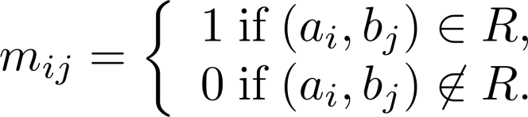
Representing Relations Using Matrices
A relation between finite sets can be represented using a zero-one matrix.
Suppose R is a relation from A = {a₁, a₂, …, a_{m}} to B = {b₁, b₂, …, b_{n}}.
  The elements of the two sets can be listed in any particular arbitrary order. When A = B, we use the same ordering.
The relation R is represented by the matrix M_{R} = [m_{ij}], where
The matrix representing R has a 1 as its (i,j) entry when a_{i} is related to b_{j} and a 0 if a_{i} is not related to b_{j}.

Slide 20
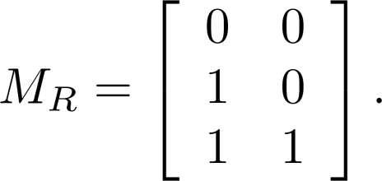
Examples of Representing Relations Using Matrices
Example 1: Suppose that A = {1,2,3} and B = {1,2}. Let R be the relation from A to B containing (a,b) if a ∈ A, b ∈ B, and a > b. What is the matrix representing R (assuming the ordering of elements is the same as the increasing numerical order)?
Solution: Because R = {(2,1), (3,1),(3,2)}, the matrix is

Slide 21
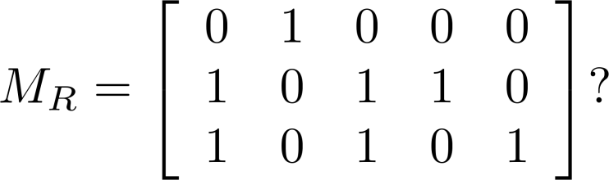
Examples of Representing Relations Using Matrices (cont.)
Example 2: Let A = {a₁,a₂, a₃} and B = {b₁,b₂, b₃,b₄, b₅}. Which ordered pairs are in the relation R represented by the matrix
Solution: Because R consists of those ordered pairs (a_{i},b_{j}) with m_{ij} = 1, it follows that:
R = {(a₁, b₂), (a₂, b₁),(a₂, b₃), (a₂, b₄),(a₃, b₁), {(a₃, b₃), (a₃, b₅)}.

Slide 22

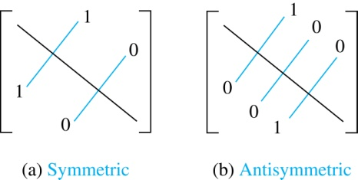
Matrices of Relations on Sets
If R is a reflexive relation, all the elements on the main diagonal of M_{R} are equal to 1.
R is a symmetric relation, if and only if m_{ij} = 1 whenever m_{ji} = 1. R is an antisymmetric relation, if and only if m_{ij} = 0 or m_{ji} = 0 when i≠ j.

Slide 23
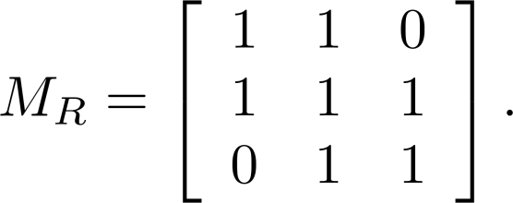
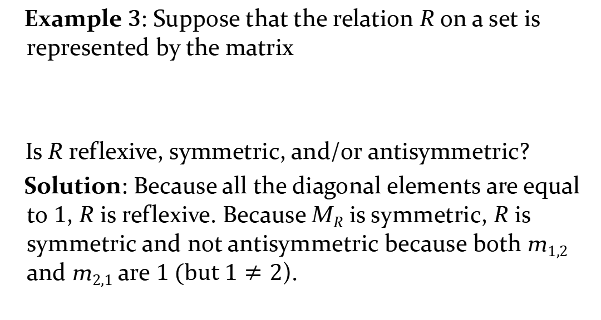
Example of a Relation on a Set
Example 3: Suppose that the relation R on a set is represented by the matrix
Is R reflexive, symmetric, and/or antisymmetric?
Solution: Because all the diagonal elements are equal to 1, R is reflexive. Because M_{R} is symmetric, R is symmetric and not antisymmetric because both m_{1,2} and m_{2,1} are 1 (but $1≠2$).

Slide 24
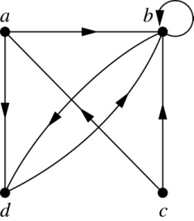
Representing Relations Using Digraphs
Definition: A directed graph, or digraph, consists of a set V of vertices (or nodes) together with a set E of ordered pairs of elements of V called edges (or arcs). The vertex a is called the initial vertex of the edge (a,b), and the vertex b is called the terminal vertex of this edge.
  An edge of the form (a,a) is called a loop.
Example 7: A drawing of the directed graph with vertices a, b, c, and d, and edges (a, b), (a, d), (b, b), (b, d), (c, a), (c, b), and (d, b) is shown here.

Slide 25
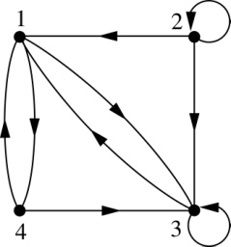
Examples of Digraphs Representing Relations
Example 8: What are the ordered pairs in the relation
represented by this directed graph?
Solution: The ordered pairs in the relation are
(1, 3), (1, 4), (2, 1), (2, 2), (2, 3), (3, 1), (3, 3), (4, 1), and (4, 3)

Slide 26
Determining which Properties a Relation has from its Digraph
Reflexivity: A loop must be present at all vertices in the graph.
Symmetry: If (x,y) is an edge, then so is (y,x).
Antisymmetry: If (x,y) with x ≠ y is an edge, then (y,x) is not an edge.
Transitivity: If (x,y) and (y,z) are edges, then so is (x,z).

Slide 27
Determining which Properties a Relation has from its Digraph – Example 1
a
b
c
d
Reflexive? No, not every vertex has a loop
Symmetric? Yes (trivially), there is no edge from one vertex to another
Antisymmetric? Yes (trivially), there is no edge from one vertex
to another
Transitive? Yes, (trivially) since there is no edge from one vertex to another

Slide 28
Determining which Properties a Relation has from its Digraph – Example 2
a
b
c
d
Reflexive? No, there are no loops
Symmetric? No, there is an edge from a to b, but not from b to a
Antisymmetric? No, there is an edge from d to b and b to d
Transitive? No, there are edges from a to c and from c to b,
but there is no edge from a to d

Slide 29
Determining which Properties a Relation has from its Digraph – Example 3
a
b
c
d
Reflexive? No, there are no loops
Symmetric? No, for example, there is no edge from c to a
Antisymmetric? Yes, whenever there is an edge from one
vertex to another, there is not one going back
Transitive? No, there is no edge from a to b

Slide 30
Determining which Properties a Relation has from its Digraph – Example 4
b
a
c
d
Reflexive? No, there are no loops
Symmetric? No, for example, there is no edge from d to a
Antisymmetric? Yes, whenever there is an edge from one vertex
to another, there is not one going back
Transitive? Yes (trivially), there are no two edges where the first
edge ends at the vertex where the second edge begins

Slide 31
Example of the Powers of a Relation
b
a
b
a
d
c
d
c
R
R²
a
b
a
b
d
c
d
c
R⁴
R³
The pair (x,y) is in R^{n} if there is a path of length n from x to y in R
(following the direction of the arrows).

